Slide 1
Assignment3 Proposal
Group 1
Chang Yu, Songzhe Zhang, You Li

Slide 2
Proposal
Macro-Analysis and prediction of energy consumption of all the properties under City of Boston
Micro-Analysis and prediction of energy consumption every single property under City of Boston

Slide 3
Proposal
Deploy a web service
Provide the prediction of the specific time and location of the properties
Provide the prediction of the overall consumption of all the properties

Slide 4
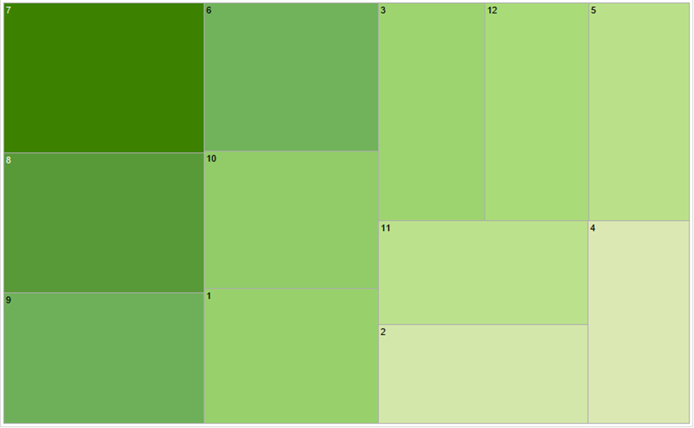
Visualization
Marco Analysis for Month

Slide 5
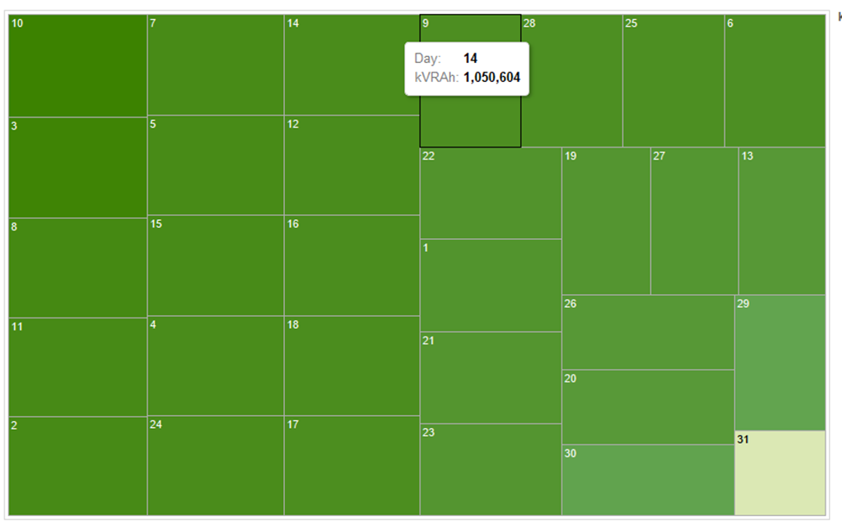
Visualization
Marco Analysis for Day

Slide 6
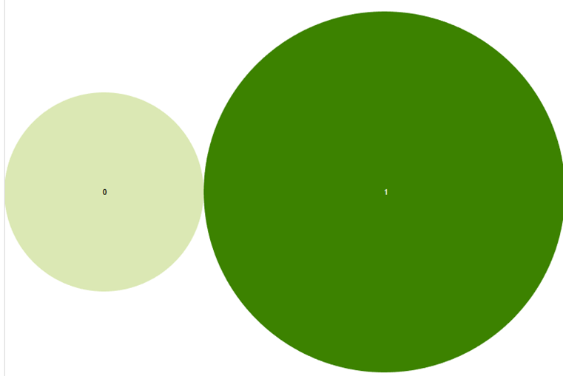
Visualization
The Marco Energy Consumption with working day and no-working day

Slide 7
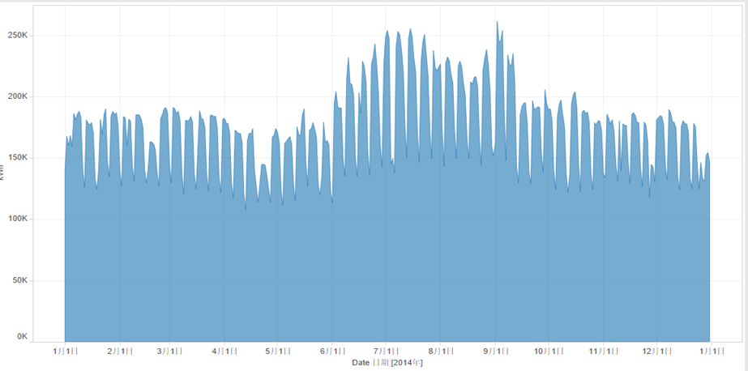
Visualization
According to the graph we can easily distinguish the changes from month to month in one year, and changes from day by day in each month. The next step for our analysis is to get the whole trend of energy consumptions in the whole year on the unit of date.

Slide 8
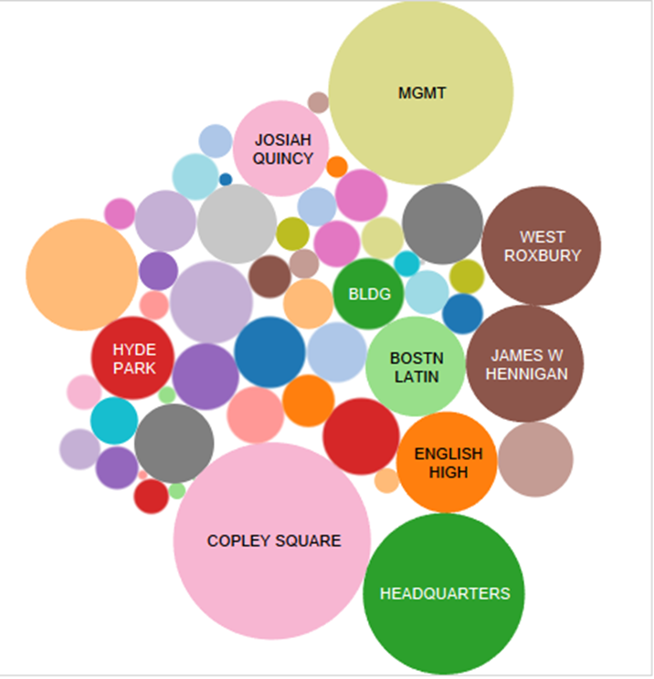
Visualization
For micro analysis, we analysis different buildings’ energy consumption range through variables

Slide 9
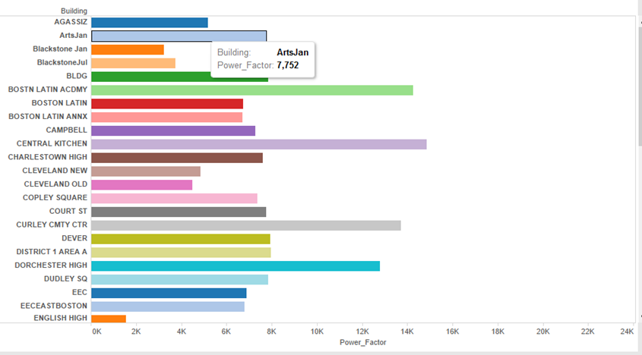
Visualization
The box-graph also offer us a clear visual for building’s power-factors.

Slide 10
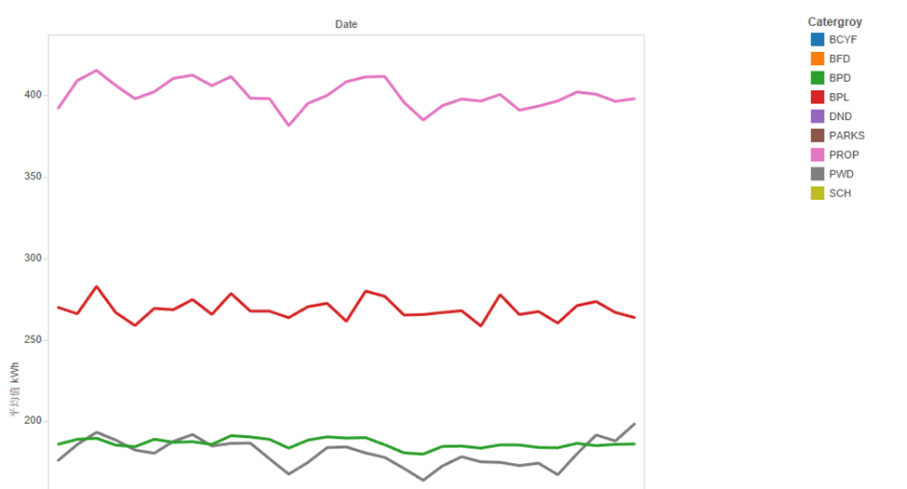
Visualization
There is also a diagram display the use of electricity of each day, though difference exit in each building, while compare to themselves, the graph seems to be stable.

Slide 11
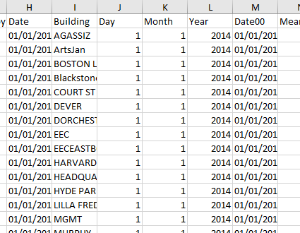
Pre-processing The Data

Slide 12
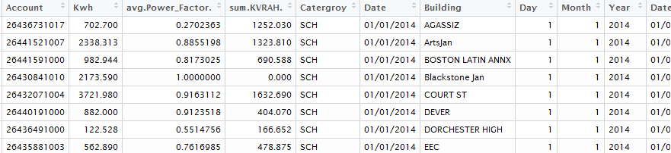
Pre-processing The Data

Slide 13
The Final Dataset

Slide 14
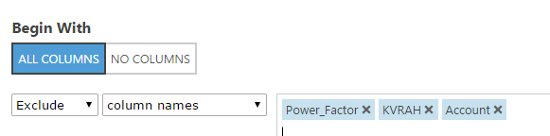
Model in Azure

Slide 15
The Final Dataset

Slide 16
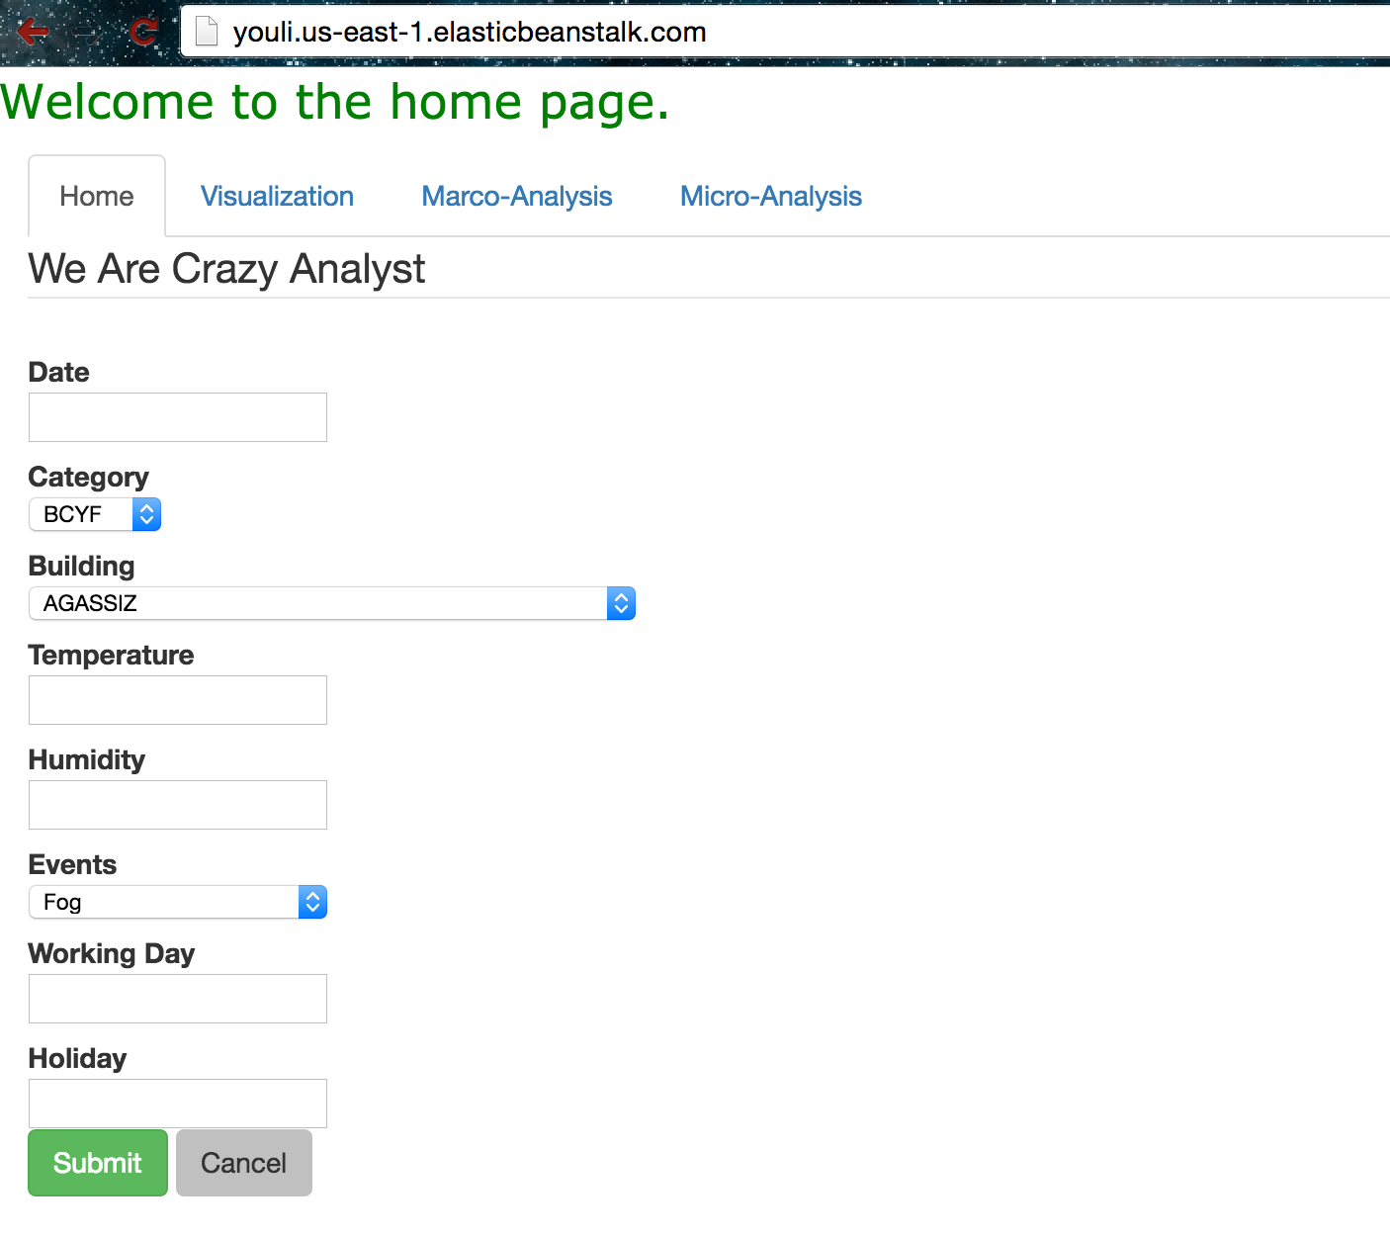
Front End

Slide 17
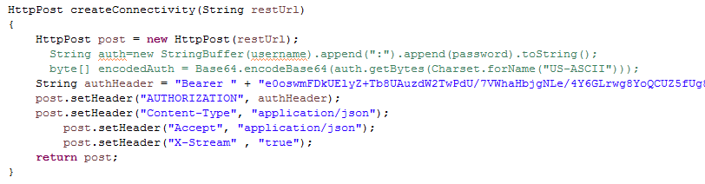
Back End
We use Spring MVC to parse the data.

Slide 18
Thank You
Q & A

